Slide 1
AI Project YABS
Self-Driving Car Course

Slide 2
Who we are
Sogol & Carl, YABS
Pradeep, Sylog, Mentor

Slide 3
What we have done
We worked through a Udemy course and met to discuss the different sections
The Complete Self-Driving Car Course - Applied Deep Learning
Some things that the course goes through:
Python
Numpy
Computer vision with OpenCV
Neural Networks with Keras
Perceptron, CNN
Project with self driving car

Slide 4
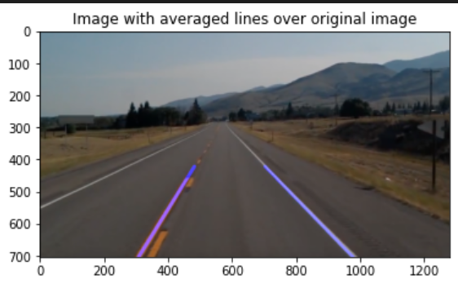
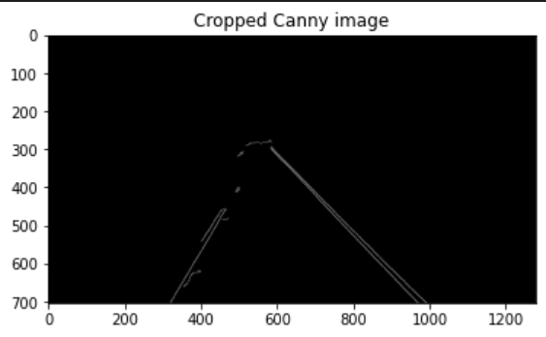
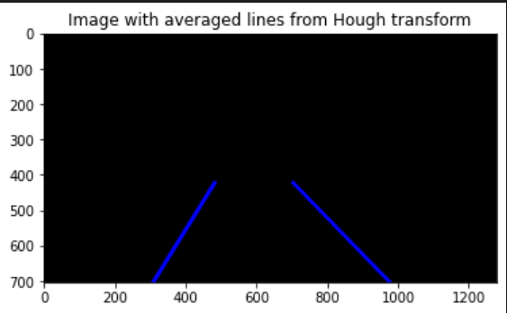
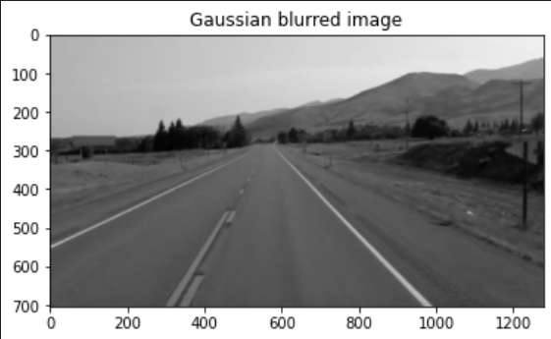
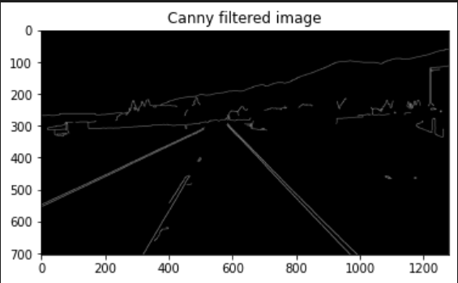
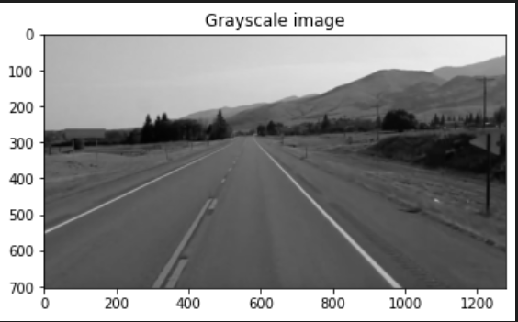
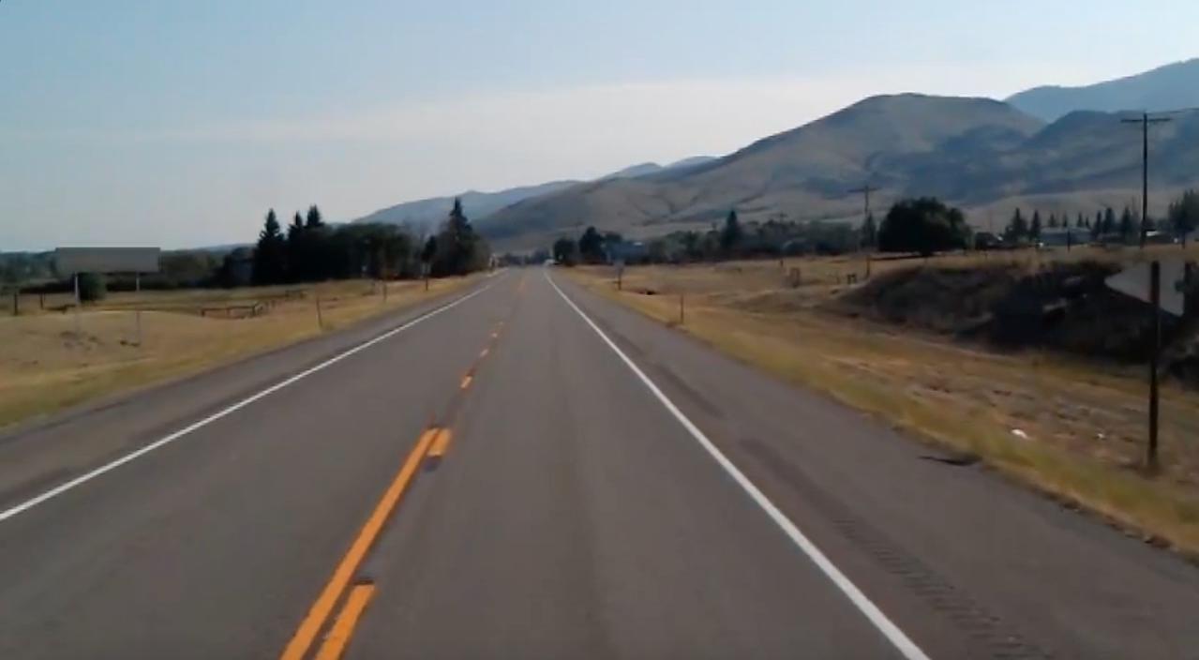
Finding Lane Lines
Goal: Use computer vision to find lane lines in this image
Steps:
Convert to grayscale
Remove noise, Gaussian blur
Detect edges, Canny edge detection
Define Region of Interest
Find lines, Hough Transform
Plot lines on original image

Slide 5
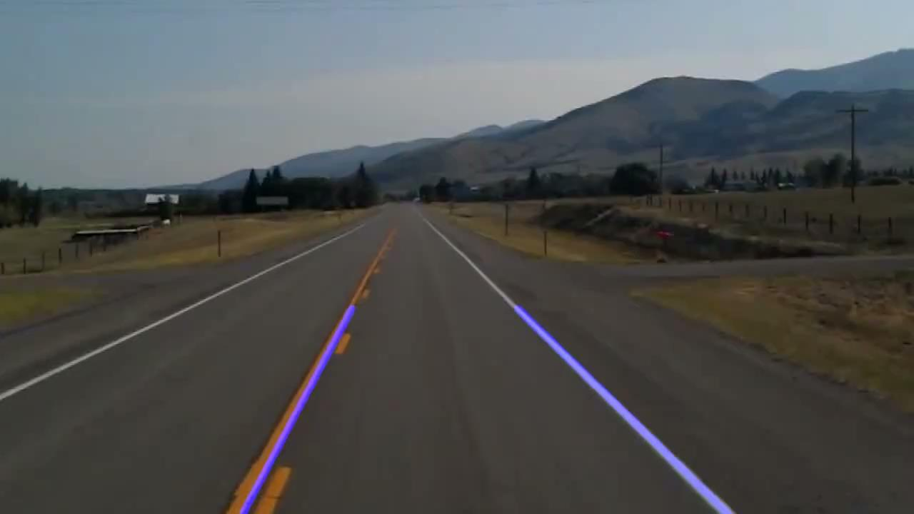
Video with found lane lines

Slide 6
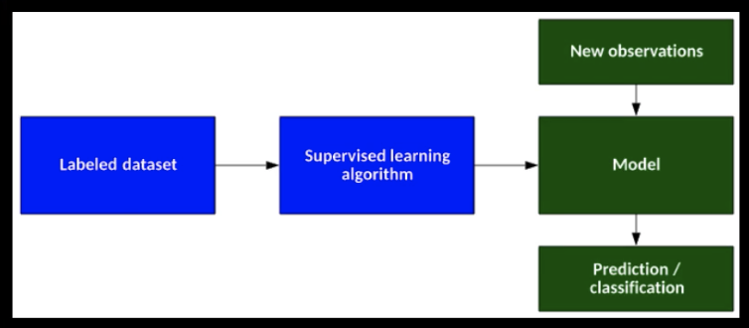
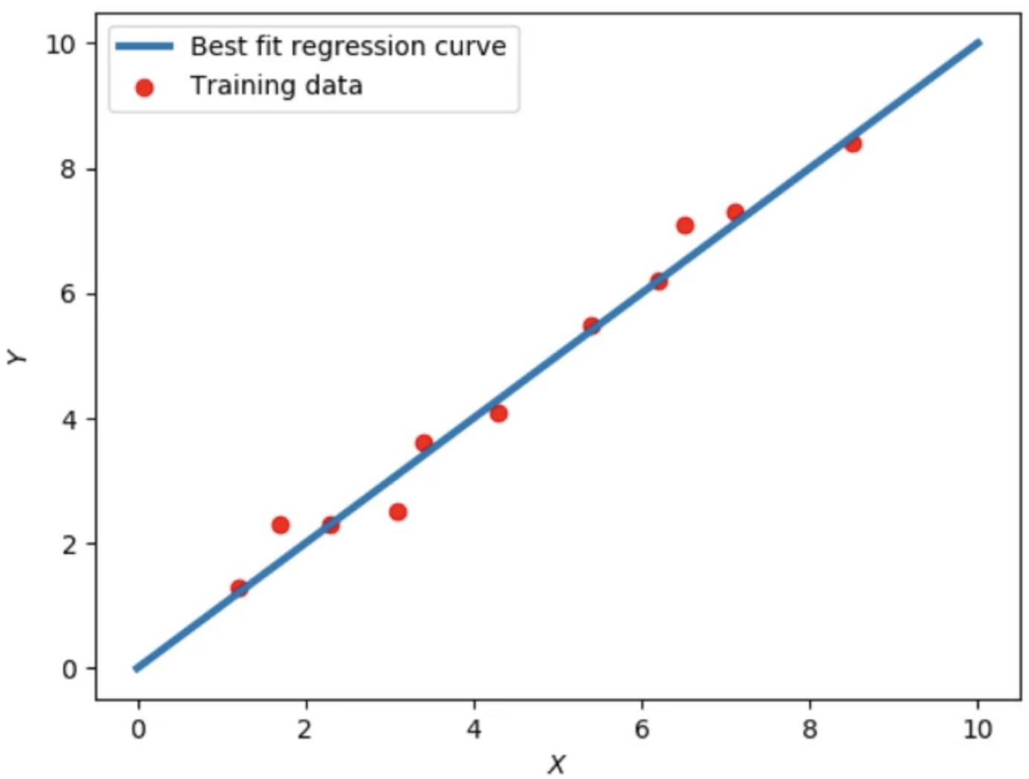
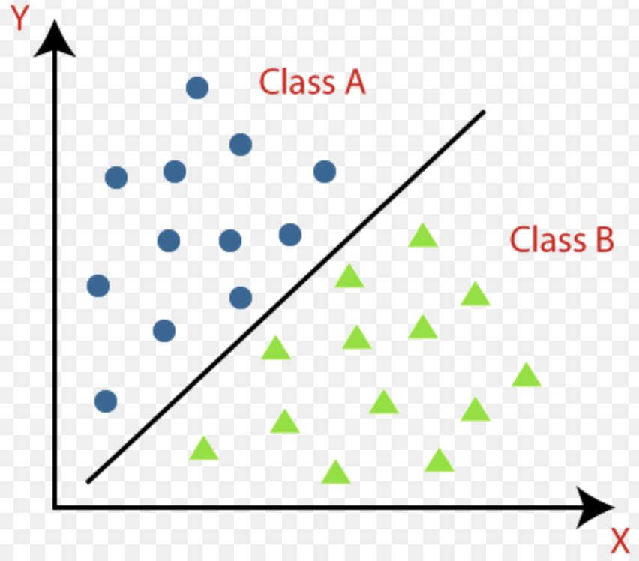
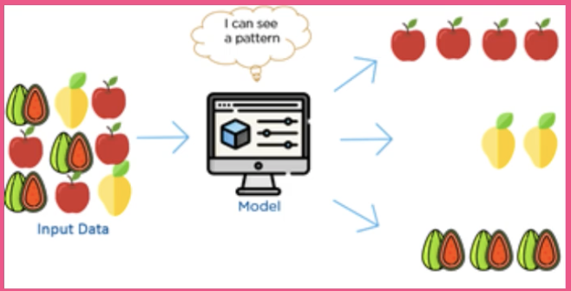
Intro to Machine Learning
Supervised Learning
Linear Regression (linearly arranged dataset)
Classification
Unsupervised Learning

Slide 7
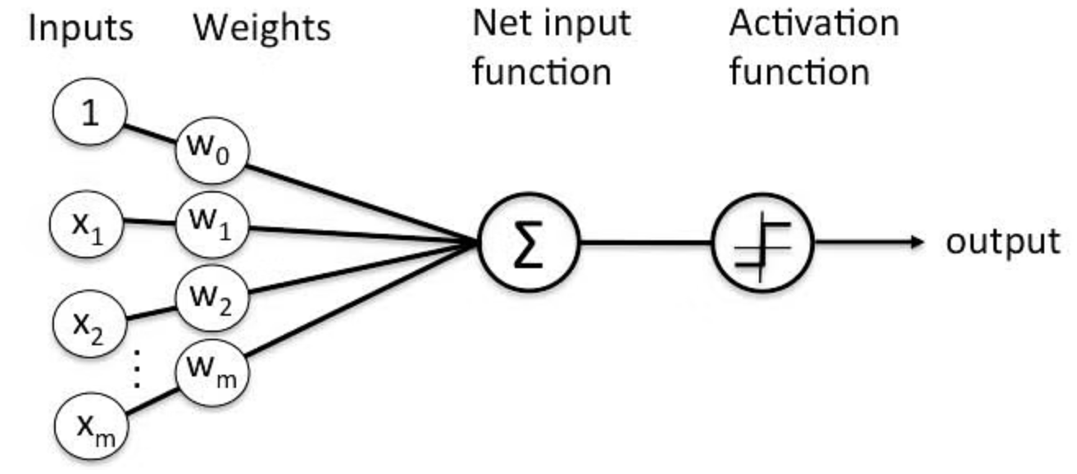
Perceptron
An algorithm for supervised learning of binary classification
Weights, the strength of the connection between the input and output
Activation function, decision making units
Types of Perceptron: - Single layer - Multilayer

Slide 8
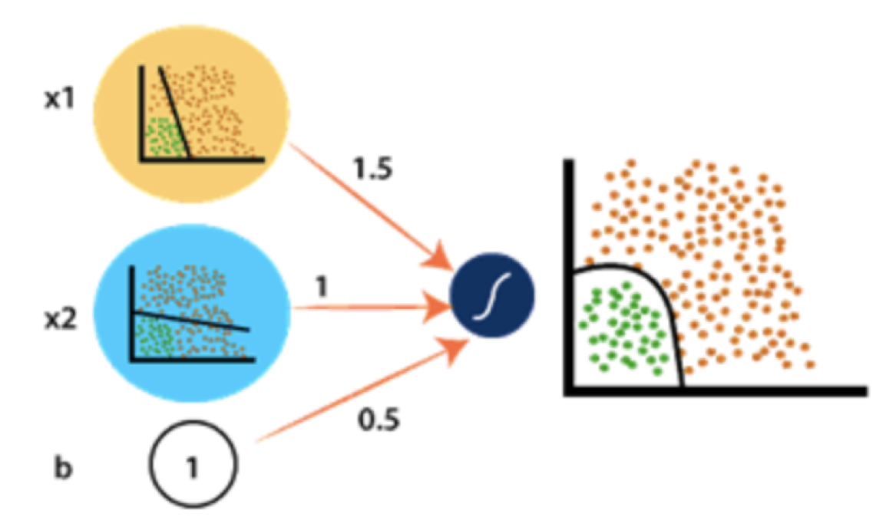
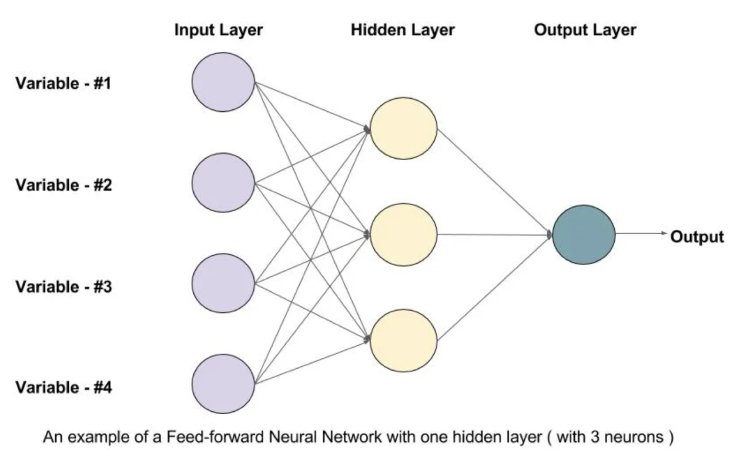
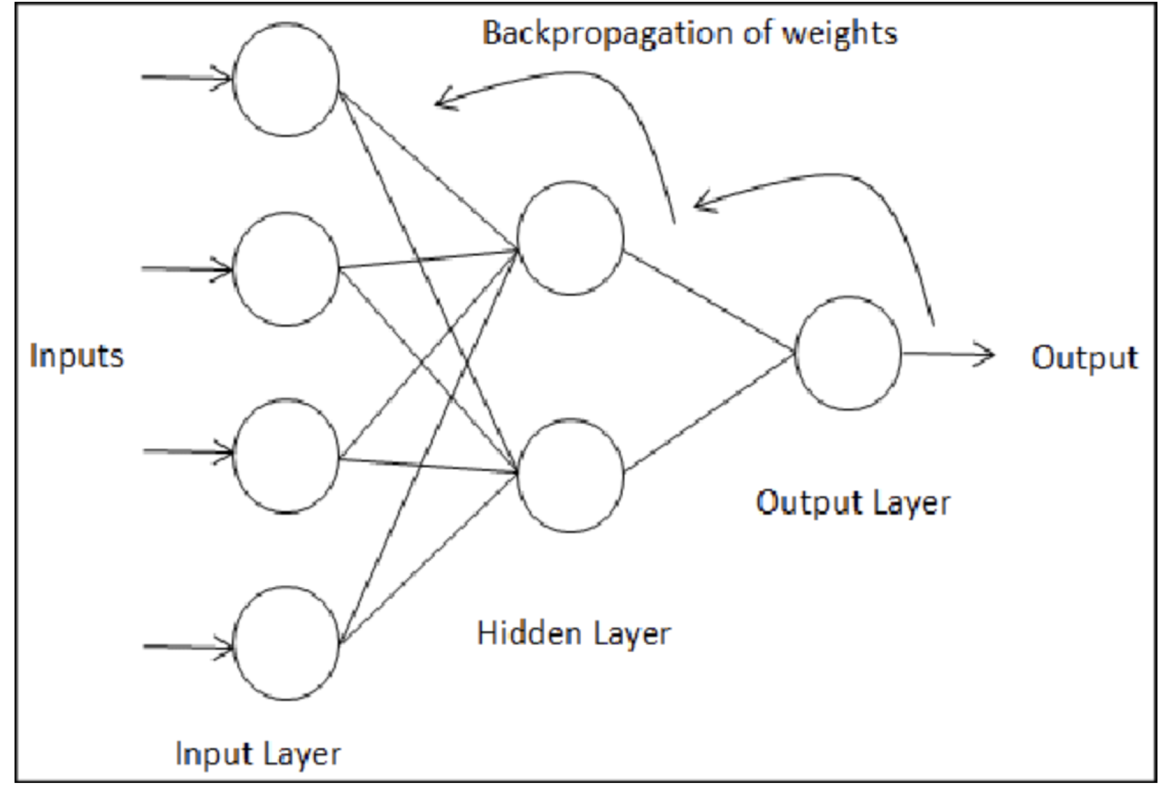
Intro to Deep Neural Networks
Non-linear model
Feedforward process
Backpropagation

Slide 9
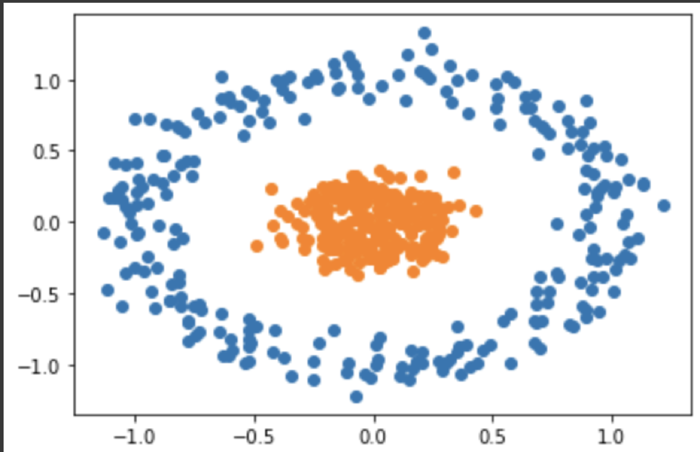
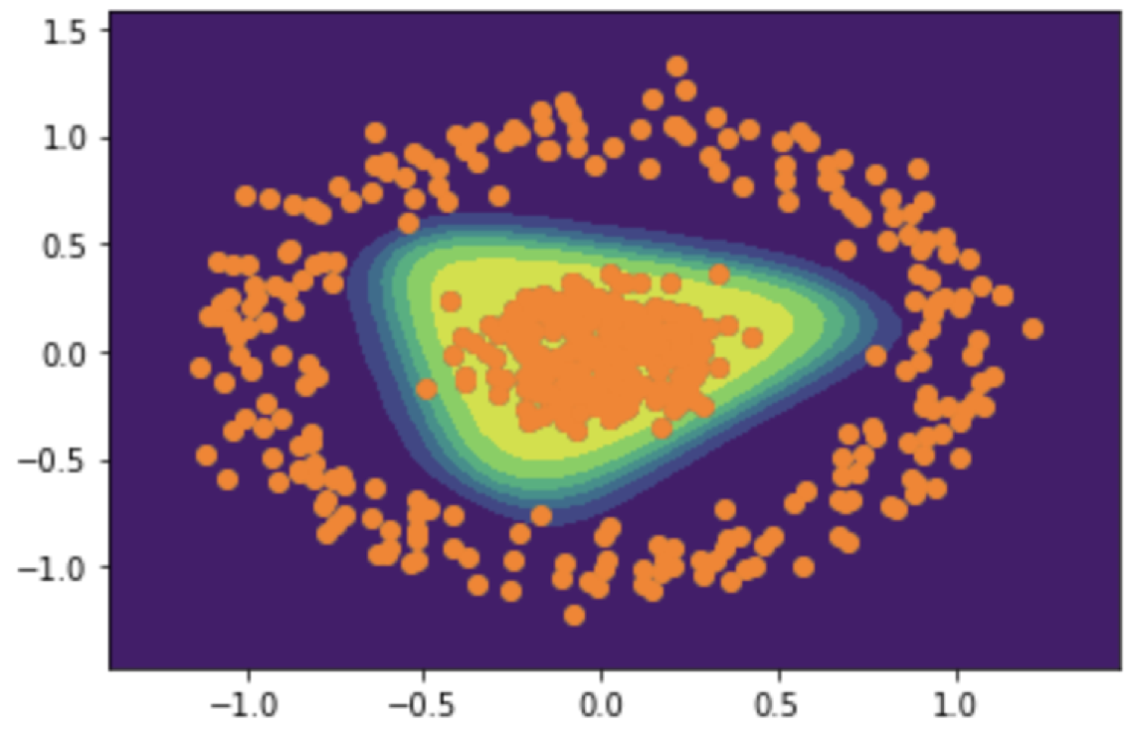
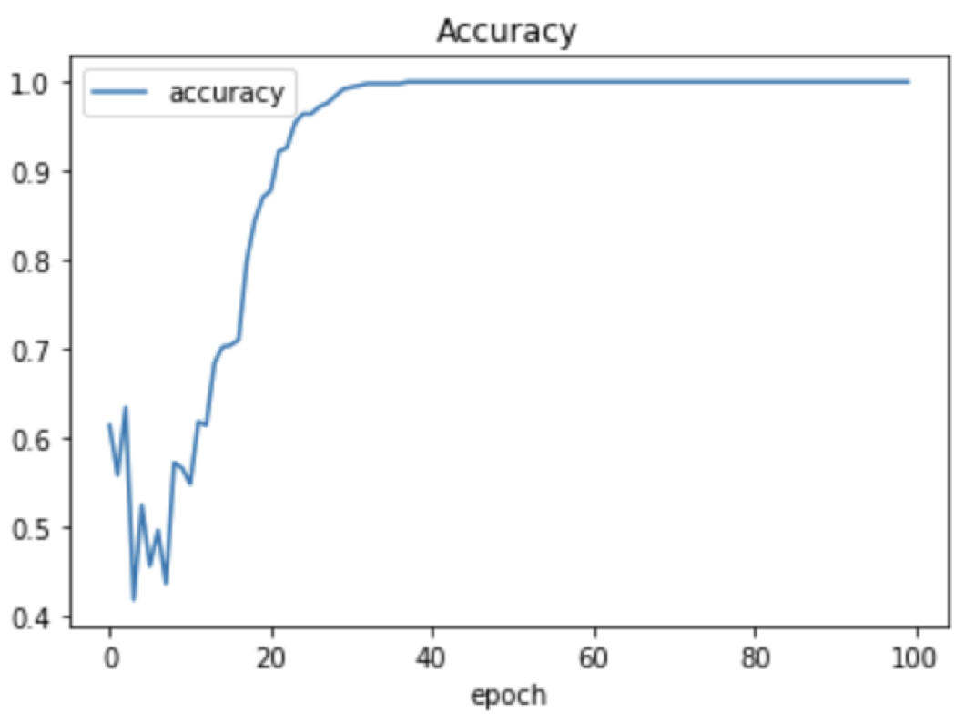
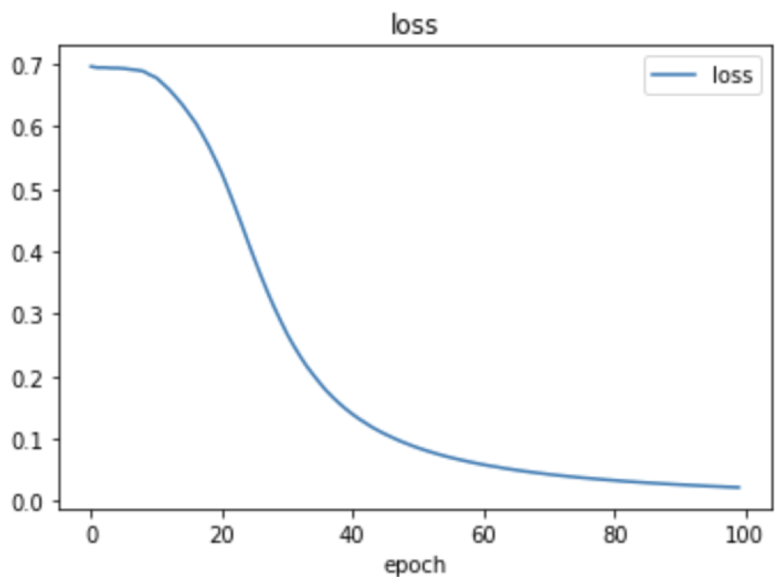
DNN in practice
Using more complex dataset from sklearn
Binary Classification of 0 or 1
Using Keras, python library for ML
Neural network with one hidden layer

Slide 10
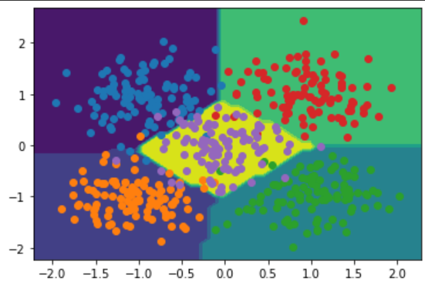
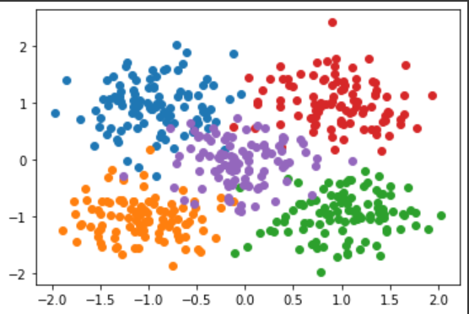
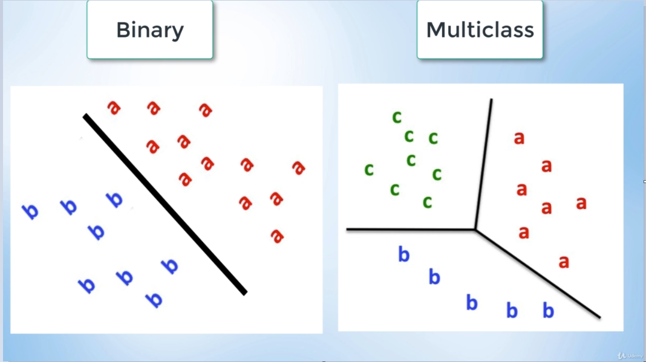
Multiclass Classification
Classify data from many classes
We used a simple neural network to classify the data in this image

Slide 11
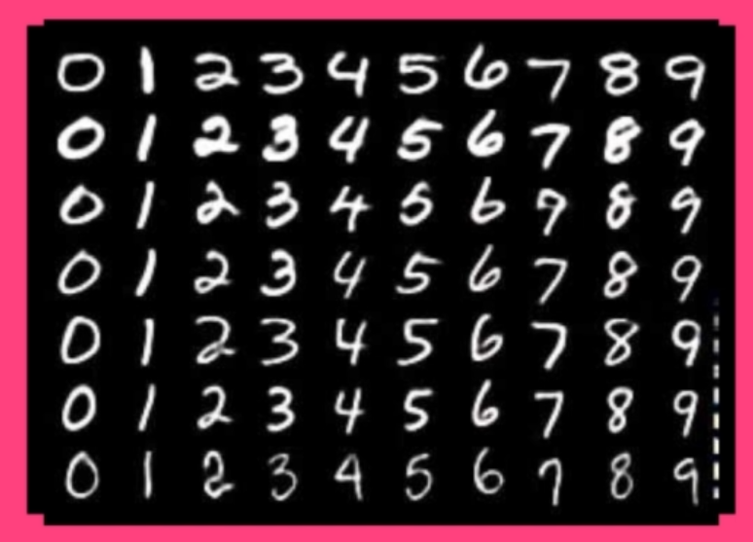
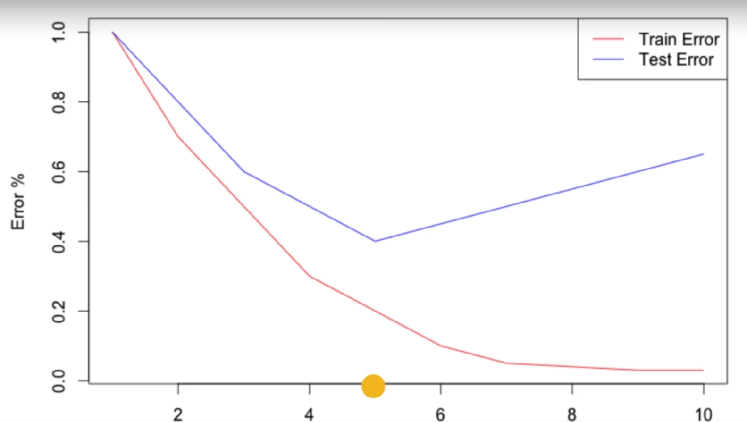
MNIST Image Recognition
Data from 10 classes, 28x28 pixel images
The neural network should be generalizable, i.e. it should be able to classify data it has never seen before
Overfitting / underfitting

Slide 12
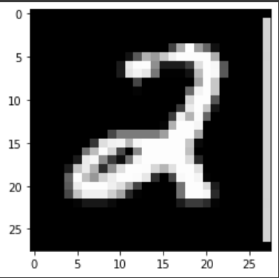
Results MNIST
Input image, our model predicts a 2!
But, our model requires many parameters and lots of training. For images we should instead use Convolutional Neural Networks

Slide 13
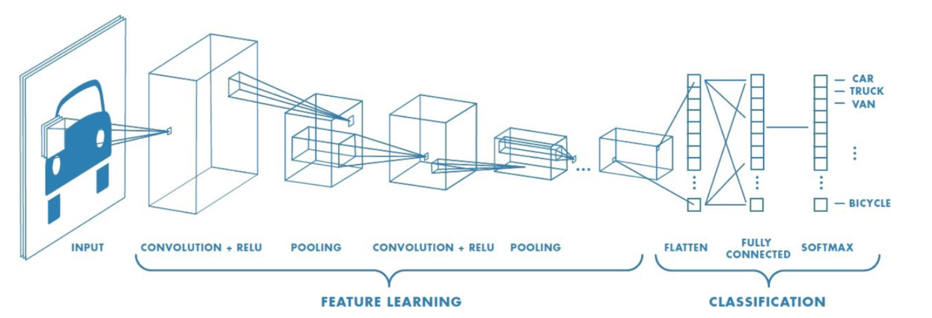
Convolutional Neural Networks (CNN)
CNN is useful for analysing and classifying images
Effective at recognising useful patterns
Applications: face recognition, object detection, identifying different traffic signs, self-driving cars
Good with computational complexity (72x72 pixels with 3 channel colored image)

Slide 14
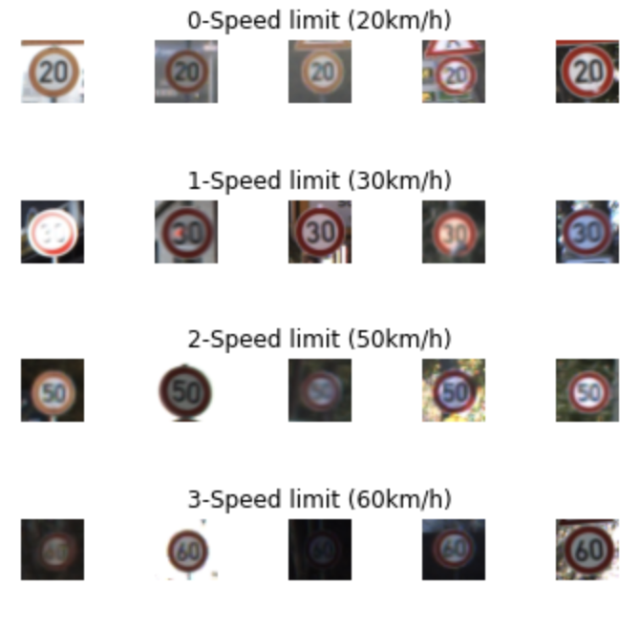
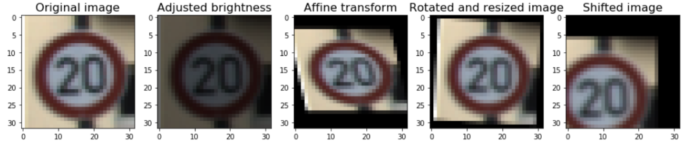
Classifying Road Signs
Open source dataset with larger dimensions and fewer images compared to MNIST
Using CNN model for classifying 43 classes
Steps:
Preprocessing images
Convert from RGB to grayscale image
Histogram equalization for normalizing lighting effect
Implementing LeNet model
Well-known CNN model
To improve the model we added Dropout and tuned the learning rate
We used augmentation technique

Slide 15
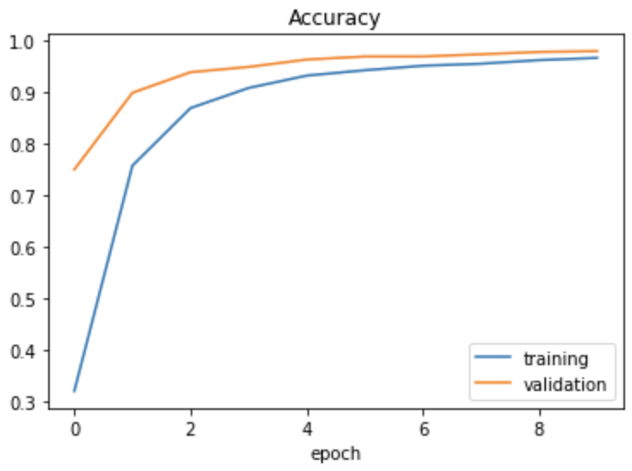
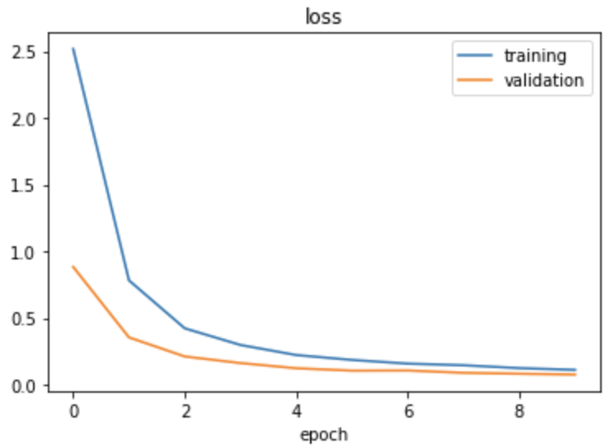
Result

Slide 16
Course Project
Self-Driving Car with Behavioural Cloning

Slide 17
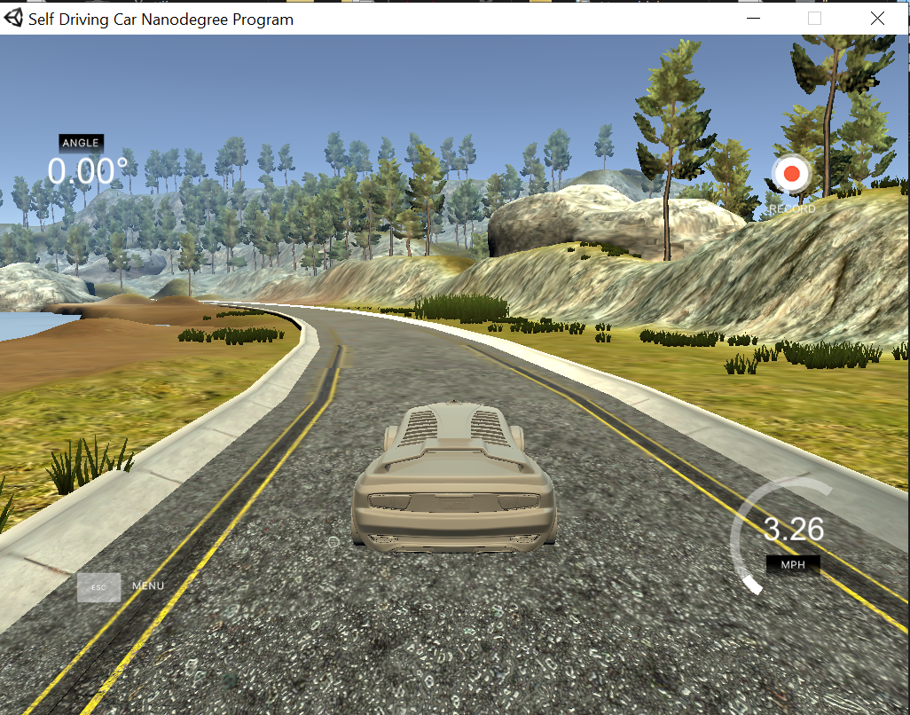
Car driving simulator
We control the car and drive it around the map
We create our own training data! Every frame we:
Take an image
Log the steering angle

Slide 18
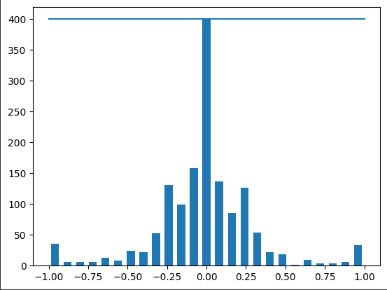
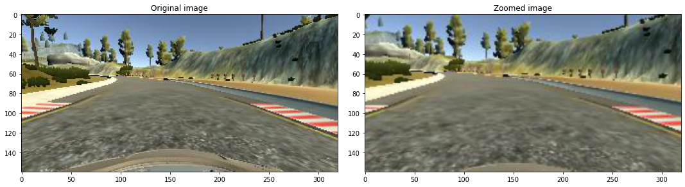
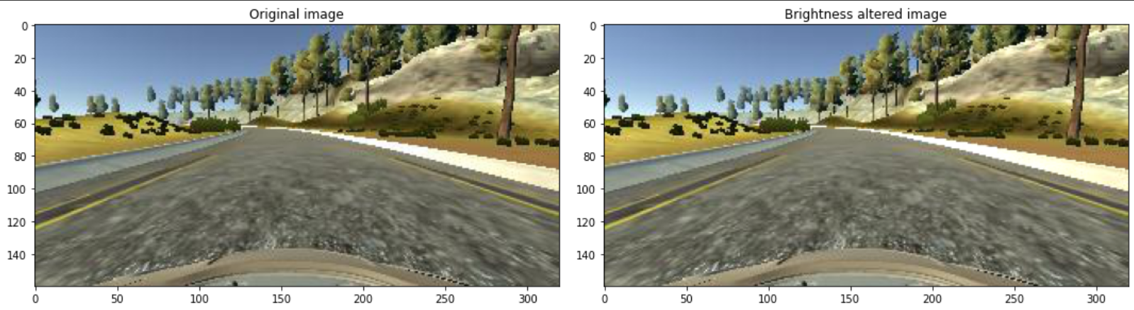
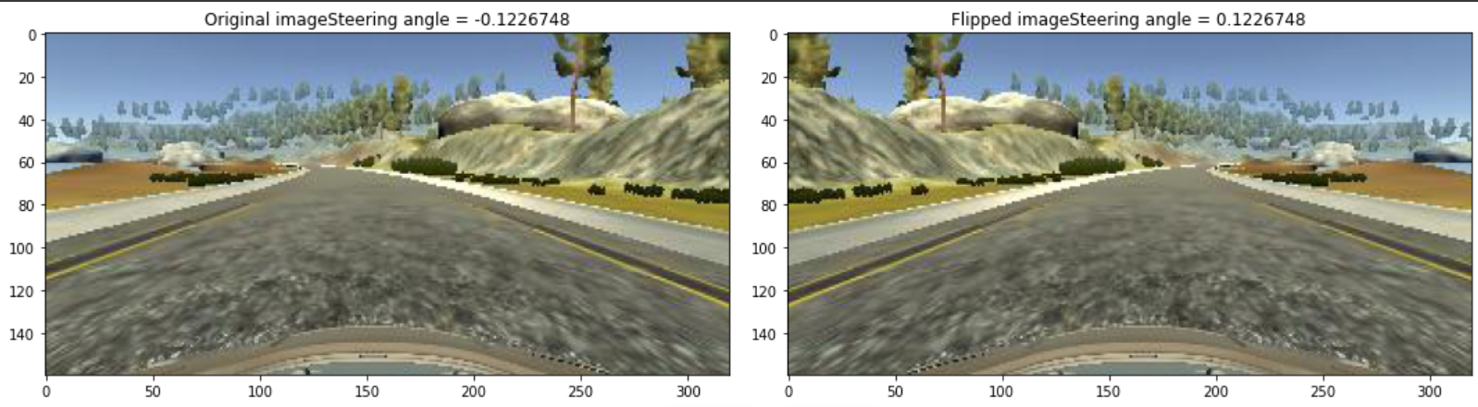
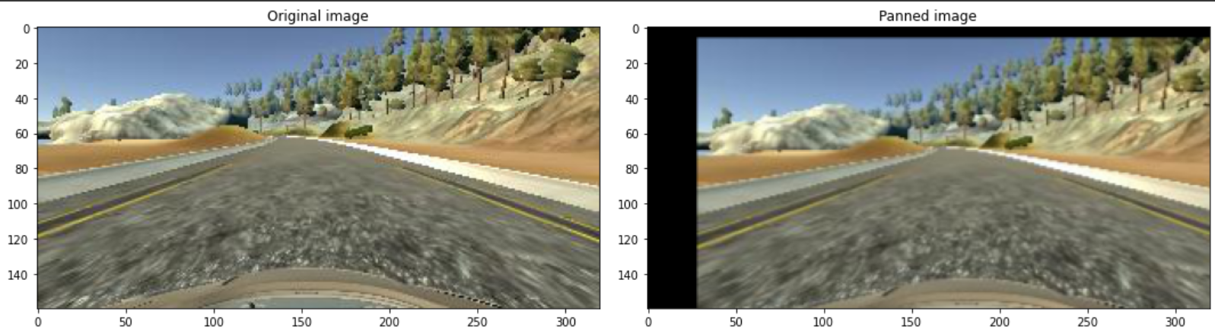
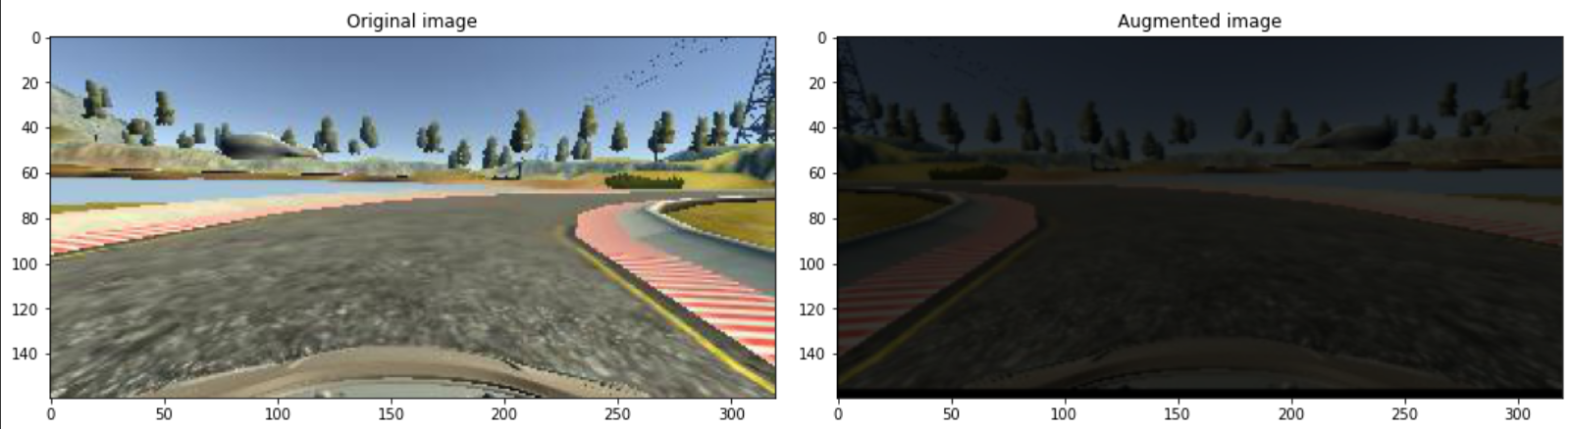
Training data
Distribution, most values are 0
We create more training data with data augmentation
Notes:
Before augmentation: 1170 training samples. 293 validation samples. 30000 images total after augmentation. 50% chance of each type of augmentation

Slide 19
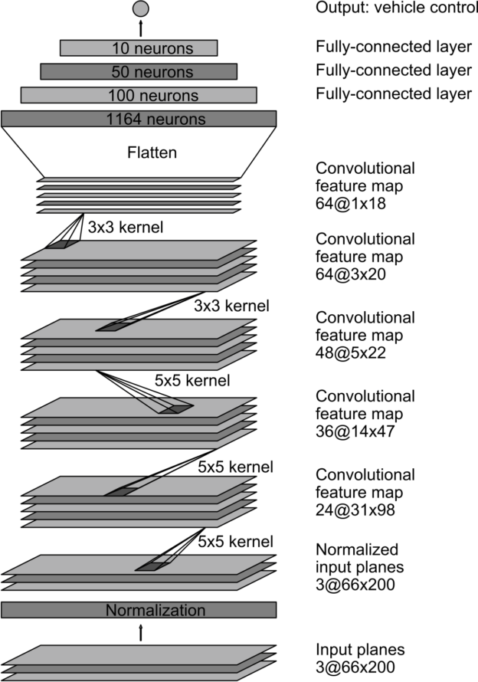
Nvidia Neural Network
Input is RGB image 66x200 pixels.
Output is the steering angle that the car should apply
Trained on the training data we created
Can now be used to drive our car!

Slide 20

Demo!

